Slide 1


Computational Intelligence (TC2027)

Slide 2
Unit 4 – Network Security (IV)
Gathering Target Information
Gathering Network and Host Information

Slide 3

Gathering Target Information

Slide 4

What is information gathering?
Information gathering (footprinting), is the process of gathering all available information about an organization.
Footprinting can be effective in identifying high-value targets, which is what hackers will be looking for to focus their efforts (help identify where the information is located, but it also helps determine the best way to gain access to the targets).
Social engineering as an information-gathering tool is highly effective at exploiting the most vulnerable asset in an organization: the people.

Slide 5


What is Reconnaissance?
Reconnaissance means the process of information gathering through the watching of the target system and gathering its information about how, when, and where they do things.
Notes:
Reconnaissance is a term comes from the military that means to actively seek an enemy’s intentions by collecting and gathering information about an enemy’s composition and capabilities via direct observation, usually by scouts or military intelligence personnel trained in surveillance.

Slide 6
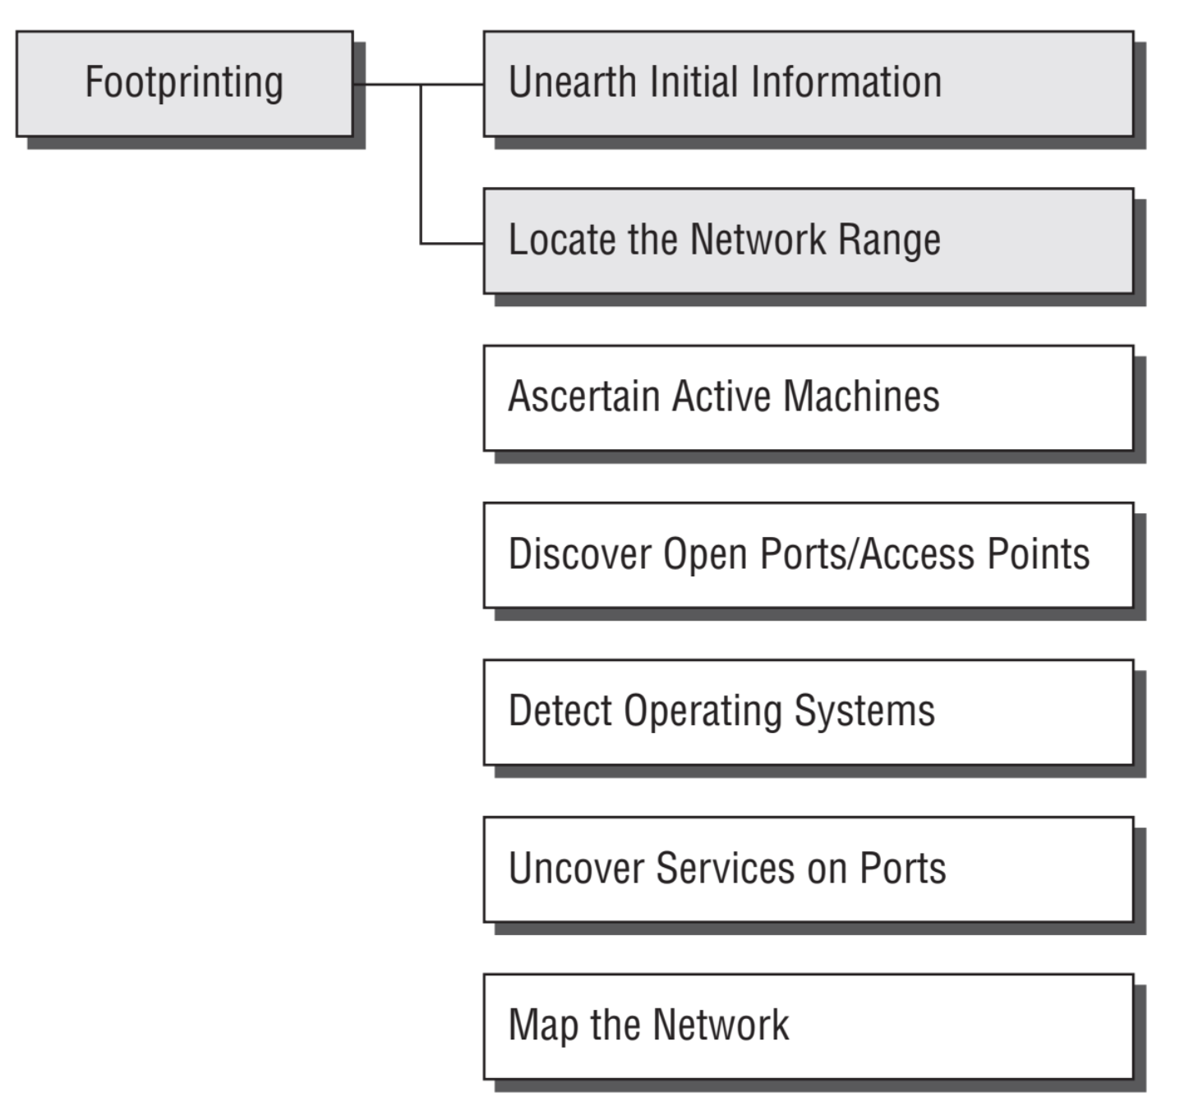
Information-Gathering Methodology
Notes:
Reconnaissance is a term comes from the military that means to actively seek an enemy’s intentions by collecting and gathering information about an enemy’s composition and capabilities via direct observation, usually by scouts or military intelligence personnel trained in surveillance.

Slide 7
Footprinting
Footprinting is defined as the process of creating a blueprint or map of an organization’s network and systems.
Footprinting begins by determining the target system, application, or physical location of the target.
Once this information is known, specific information about the organization is gathered using nonintrusive methods.

Slide 8
Footprinting
The target information is anything that gives clues as to the network architecture, server, and application types where valuable data is stored.
Domain name
Network blocks
Network services and applications
System architecture
Intrusion detection system
Authentication mechanisms
Specific IP addresses
Access control mechanisms
Phone numbers
Contact addresses

Slide 9
Footprinting Tools
Footprinting can be done using hacking tools, either applications or websites, which allow the hacker to locate information passively.
Domain name lookup
Whois
NSlookup
Sam Spade

Slide 10

Using Google to Gather Information
https://support.google.com/websearch/answer/2466433?hl=en

Slide 11
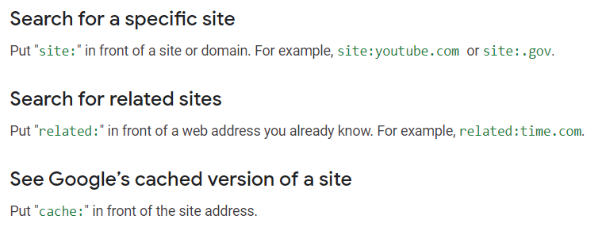
Using Google to Gather Information
https://support.google.com/websearch/answer/2466433?hl=en

Slide 12
DNS Enumeration
DNS Enumeration is the process of locating all the DNS servers and their corresponding records for an organization.
DNS Enumeration is used to gather as many interesting details as possible about your target before initiating an attack.
DNS servers that can yield information such as usernames, computer names, and IP addresses of potential target systems.
Information gathered by DNS Enumeration can be used by an attacker in various breaches, especially while initiating DNS Tunneling.

Slide 13
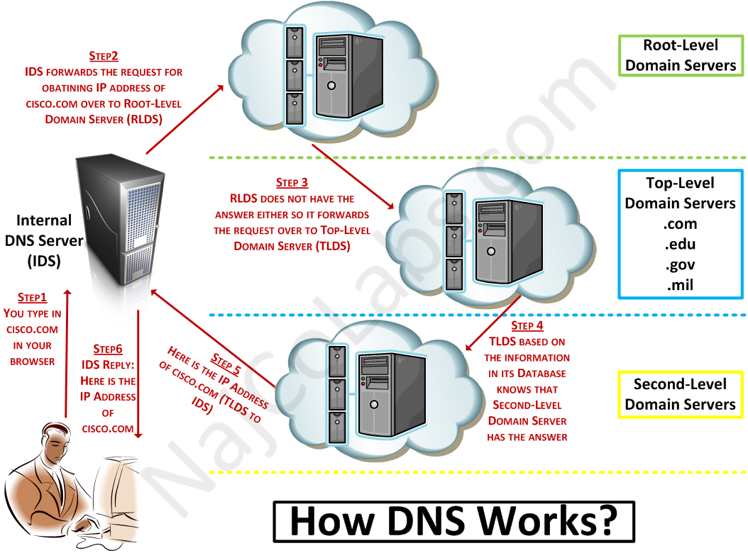

Slide 14
Nslookup & Whois
Nslookup and Whois are tool’s queries DNS servers for record information. It’s included in Unix, Linux, and Windows operating systems. Hacking tools such as Sam Spade also include NSlookup tools.
Building on the information gathered from Whois, you can use NSlookup to find additional IP addresses for servers and other hosts.
Using the authoritative name server information from Whois (AUTH1.NS.NYI.NET), you can discover the IP address of the mail server.

Slide 15
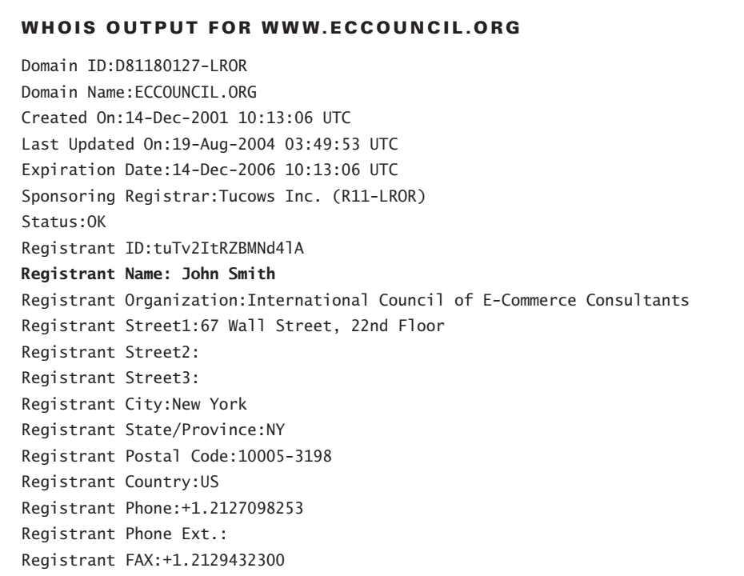
Whois Example

Slide 16
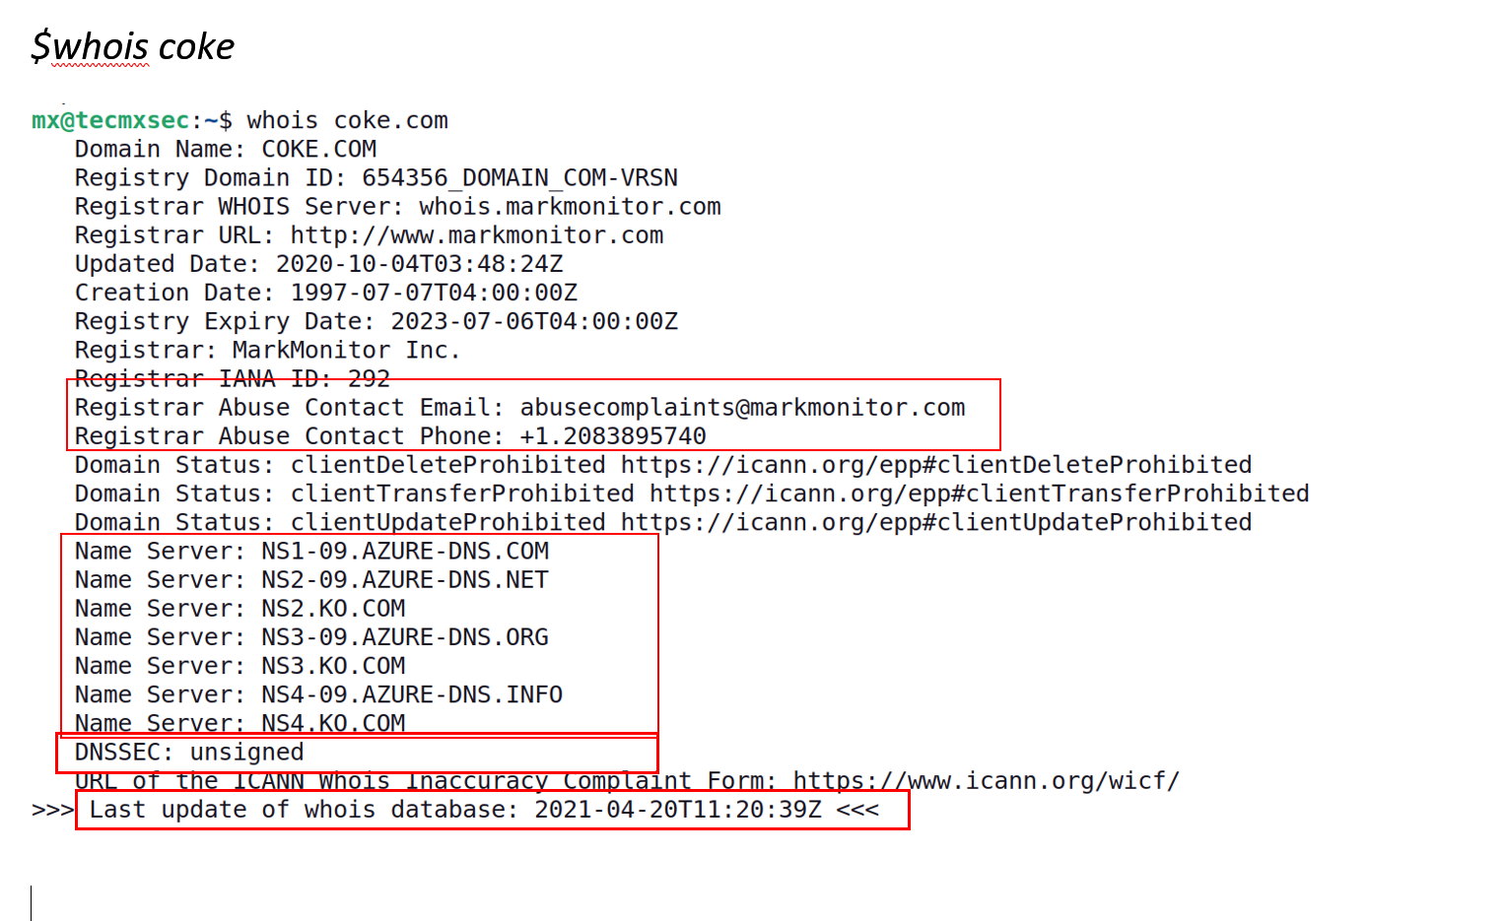
Whois Example
(Ubuntu) #apt-get install whois
$whois coke

Slide 17
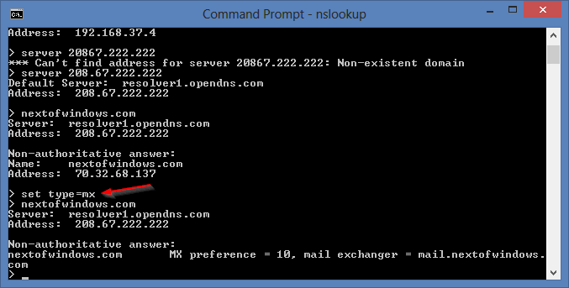
Nslookup Example

Slide 18
Identifying Types of DNS Records
A (Address) Maps a hostname to an IP address
SOA (Start of Authority) Identifies the DNS server responsible for the domain information
CNAME (Canonical Name) Provides additional names or aliases for the address record
MX (Mail Exchange) Identifies the mail server for the domain
SRV (Service) Identifies services such as directory services
PTR (Pointer) Maps IP addresses to hostnames
NS (Name Server) Identifies other name servers for the domain.

Slide 19
Using Traceroute in Footprinting
Traceroute is a packet-tracking tool that is available for most operating systems.
It operates by sending an Internet Control Message Protocol (ICMP) echo to each hop (router or gateway) along the path, until the destination address is reached.
When ICMP messages are sent back from the router, the time to live (TTL) is decremented by one for each router along the path.
This allows a hacker to determine how many hops a router is from the sender.

Slide 20
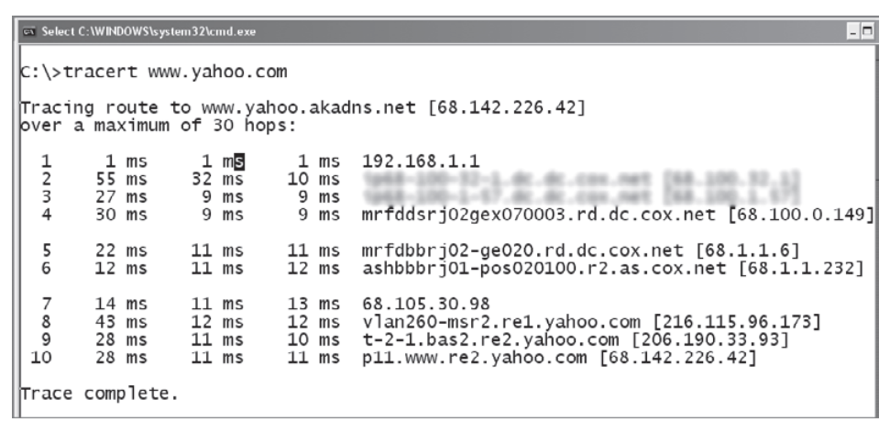
Using Traceroute in Footprinting

Slide 21
Web Crawlers (Web Spiders)
A Web crawler is one type of bot , or software agent. In general, it starts with a list of URLs to visit, called the seeds.
As the crawler visits these URLs, it identifies all the hyperlinks in the page and adds them to the list of URLs to visit, called the crawl frontier.
URLs from the frontier are recursively visited according to a set of policies.
The web spider uses syntax such as the @ symbol to locate email addresses and then copies them into a list. These addresses are then added to a database and may be used later to send unsolicited emails.
Spammers and anyone else interested in collecting email addresses from the Internet can use web spiders.

Slide 22
Web Crawlers (Web Spiders)
Examples of a few web spiders:
Yahoo!Slurp
bingbot
FAST CRAWLER
Googlebot
polybot
web crawler
APSEEK
GNUwget
YaCy
Seeks
Nutch

Slide 23
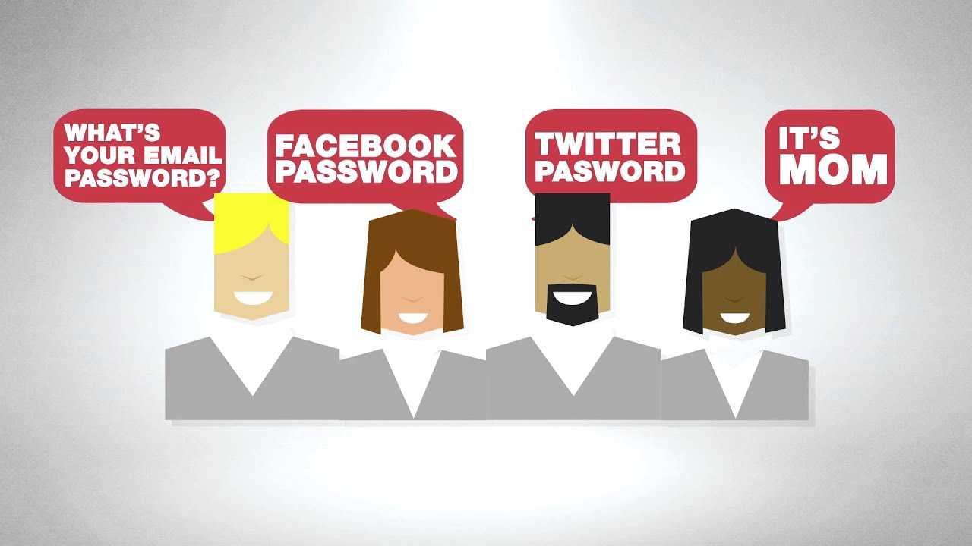
Social Engineering
Social engineering is a nontechnical method of breaking into a system or network. It’s the process of deceiving users of a system and convincing them to perform acts useful to the hacker, such as giving out information that can be used to defeat or bypass security mechanisms.

Slide 24
Types of Social Engineering Attacks
Human-based social engineering refers to person-to-person interaction to retrieve the desired information. An example is calling the help desk and trying to find out a password.
Computer-based social engineering refers to having computer software that attempts to retrieve the desired information. An example is sending a user an email and asking them to reenter a password in a web page to confirm it. This social-engineering attack is also known as phishing.

Slide 25
Human-Based Social Engineering Attacks
Impersonating an Employee or Valid User: the hacker pretends to be an employee or valid user on the system.
Posing as an Important User: the hacker pretends to be an important user such as an executive or high-level manager who needs immediate assistance to gain access to a computer system or files.
Using a Third Person: a hacker pretends to have permission from an authorized source to use a system. This attack is especially effective if the supposed authorized source is on vacation or can’t be contacted for verification.

Slide 26
Computer-Based Social Engineering Attacks
Email attachments
Fake websites
Pop-up windows

Slide 27
Phishing Attacks
Phishing attacks are the practice of sending fraudulent communications that appear to come from a reputable source.
It is usually performed through email. The goal is to steal sensitive data like credit card and login information or to install malware on the victim's machine.
Phishing is a common type of cyber attack that everyone should learn about in order to protect themselves.

Slide 28
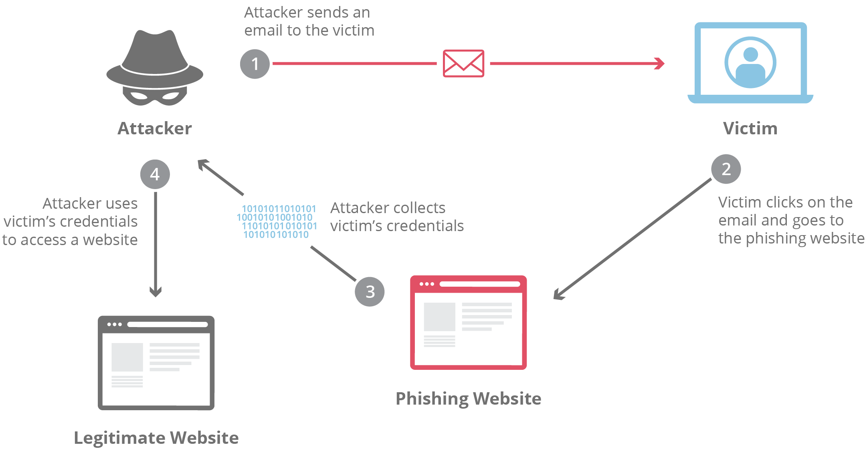
Phishing Attacks

Slide 29
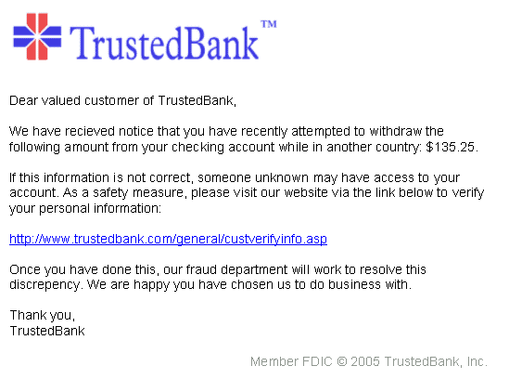
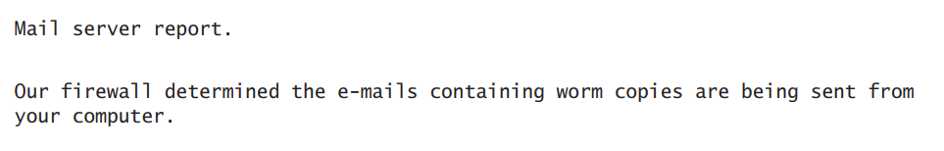
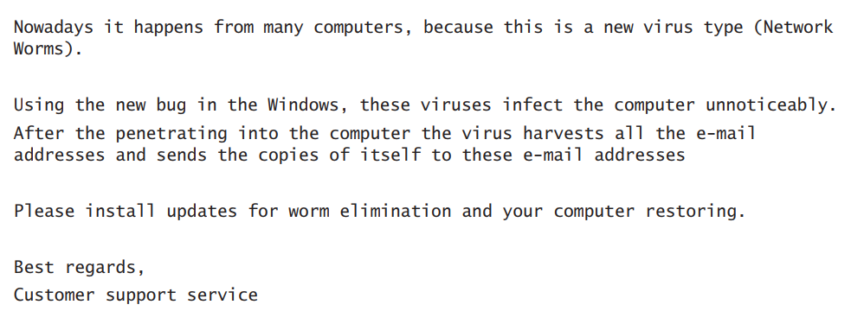
Phishing Attacks Examples

Slide 30
URL Obfuscation
The URL (uniform resource locator) is commonly used in the address bar of a web browser to access a particular website.
In lay terms, it is the website address. URL obfuscation consists of hiding a fake URL in what appear to be a legitimate website address.
For example, a website of 204.13.144.2/Citibank may appear to be a legitimate web address for Citibank but in fact is not.

Slide 31
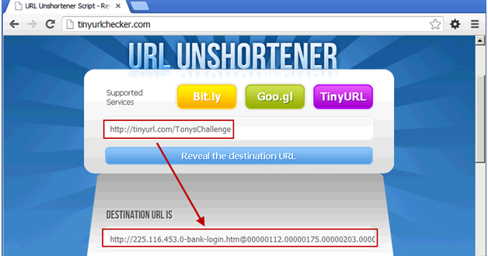
URL Obfuscation

Slide 32
URL Obfuscation
URL obfuscation is used in phishing attacks and some online scams to make the scam seem more legitimate.
A website address may be seen as an actual financial institution name or logo, but the link leads to a fake website or IP address. When users click the link, they’re redirected to the hacker’s site.
Addresses can be obfuscated in malicious links by the use of hexadecimal or decimal notations. For example, the address 192.168.10.5 looks like 3232238085 as a decimal. The same address looks like C0A80A05 in IP hex.

Slide 33
Gathering Network and Host Information

Slide 34
Information-Gathering Methodology
Notes:
Reconnaissance is a term comes from the military that means to actively seek an enemy’s intentions by collecting and gathering information about an enemy’s composition and capabilities via direct observation, usually by scouts or military intelligence personnel trained in surveillance.

Slide 35
Scanning
Scanning is the first phase of active hacking and is used to locate target systems or networks for later attack.
It is important that the information-gathering stage be as complete as possible to identify the best location and targets to scan.
During scanning, the hacker continues to gather information regarding the network and its individual host systems.
Information such as IP addresses, operating system, services, and installed applications can help the hacker determine which type of exploit to use in hacking a system.

Slide 36
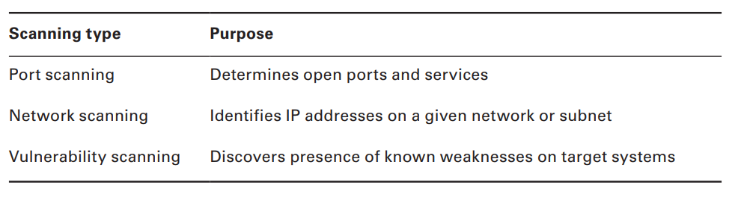
Scanning Type

Slide 37
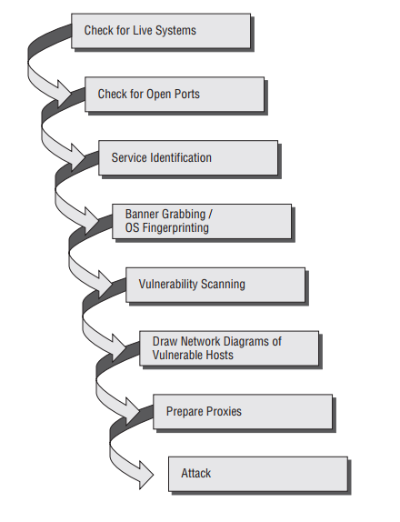
Ethical Hacking Scanning Methodology

Slide 38
Ping Sweep Techniques
The simplest, although not necessarily the most accurate, way to determine whether systems are live is to perform a ping sweep of the IP address range.
All systems that respond with a ping reply are considered live on the network.
A ping sweep is also known as Internet Control Message Protocol (ICMP) scanning, as ICMP is the protocol used by the ping command.

Slide 39
Ping Sweep Techniques
One considerable problem with this method is that personal firewall software and network-based firewalls can block a system from responding to ping sweeps.
More and more systems are configured with firewall software and will block the ping attempt and notify the user that a scanning program is running on the network.

Slide 40

Nmap
Nmap is a free, open-source tool that quickly and efficiently performs ping sweeps, port scanning, service identification, IP address detection, and operating system detection.
Nmap has the benefit of scanning many machines in a single session.
It’s supported by many operating systems, including Unix, Windows, and Linux.

Slide 41
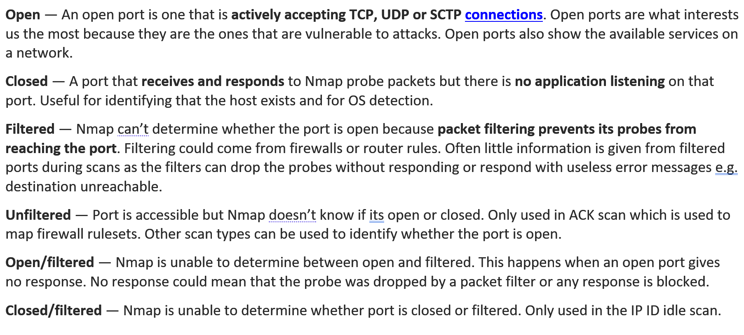
Nmap
The state of the port as determined by a nmap scan can be: open, filtered, or unfiltered.

Slide 42
Scan Types
SYN or stealth scan: is also called a half-open scan because it doesn’t complete the TCP three-way handshake. A hacker sends a SYN packet to the target; if a SYN/ACK frame is received back, then it’s assumed the target would complete the connect and the port is listening. If an RST is received back from the target, then it’s assumed the port isn’t active or is closed. The advantage of the SYN stealth scan is that fewer IDS systems log this as an attack or connection attempt.
IDLE uses a spoofed IP address to send a SYN packet to a target. Depending on the response, the port can be determined to be open or closed. IDLE scans determine port scan response by monitoring IP header sequence numbers

Slide 43
Scan Types
XMAS: send a packet with the FIN, URG, and PSH flags set. If the port is open, there is no response; but if the port is closed, the target responds with an RST/ACK packet. XMAS scans work only on target systems that follow the RFC 793 implementation of TCP/IP and don’t work against any version of Windows.
FIN: it is similar to an XMAS scan but sends a packet with just the FIN flag set. FIN scans receive the same response and have the same limitations as XMAS scans.
NULL: it is also similar to XMAS and FIN in its limitations and response, but it just sends a packet with no flags set.

Slide 44
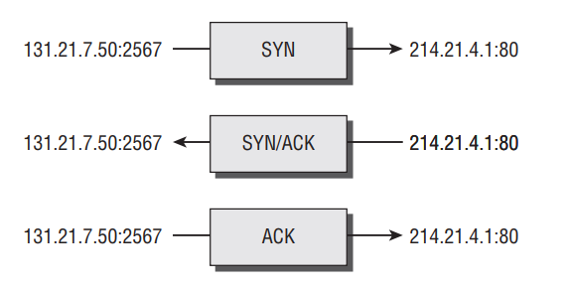
TCP Communication Flag Types
SYN (Synchronize): Initiates a connection between hosts.
ACK (Acknowledge): Established connection between hosts.
PSH (Push): System is forwarding buffered data.
URG (Urgent): Data in packets must be processed quickly.
FIN (Finish): No more transmissions.
RST (Reset): Resets the connection.

Slide 45
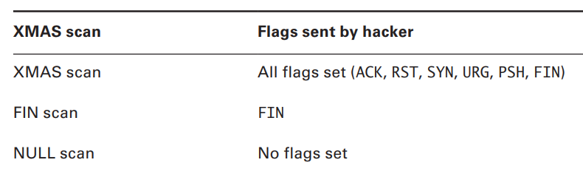
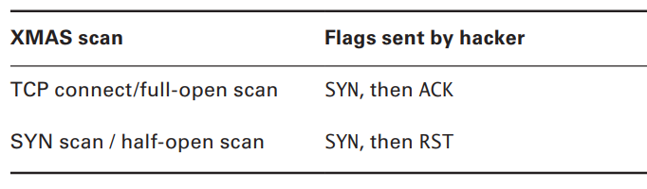
TCP Scan Types

Slide 46
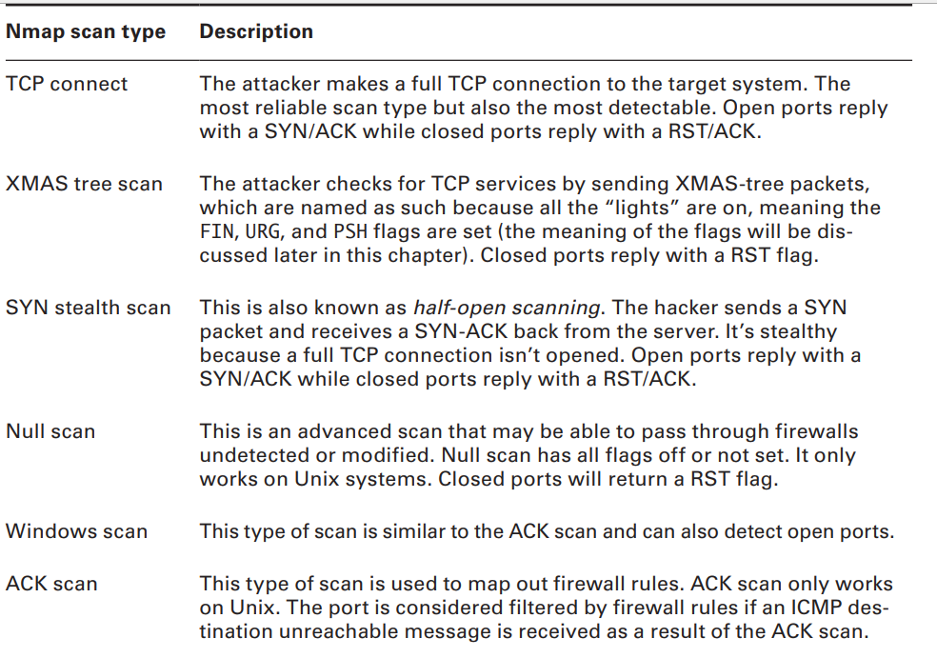

Slide 47
Banner Grabbing and OS Fingerprinting Techniques
Active stack fingerprinting
It involves sending data to a system to see how the system responds.
It’s based on the fact that various operating system vendors implement the TCP stack differently, and responses will differ based on the operating system.
The responses are then compared to a database to determine the operating system.
Active stack fingerprinting is detectable because it repeatedly attempts to connect with the same target system.

Slide 48
Banner Grabbing and OS Fingerprinting Techniques
Passive stack fingerprinting:
It is stealthier and involves examining traffic on the network to determine the operating system.
It uses sniffing techniques instead of scanning techniques.
Passive stack fingerprinting usually goes undetected by an IDS or other security system but is less accurate than active fingerprinting.

Slide 49
Enumeration
Enumeration occurs after scanning and is the process of gathering and compiling usernames, machine names, network resources, shares, and services.
It also refers to actively querying or connecting to a target system to acquire this information.
1. Extract usernames using enumeration. 2. Gather information about the host using null sessions. 3. Perform Windows enumeration using the SuperScan tool. 4. Acquire the user accounts using the tool GetAcct. 5. Perform SNMP port scanning.

Slide 50

Null Sessions
A null session occurs when you log in to a system with no username or password.
NetBIOS null sessions are a vulnerability found in the Common Internet File System (CIFS) or SMB, depending on the operating system.
Once a hacker has made a NetBIOS connection using a null session to a system, they can easily get a full dump of all usernames, groups, shares, permissions, policies, services, and more using the Null user account.
One method of connecting a NetBIOS null session to a Windows system is to use the hidden Inter-Process Communication share (IPC$). This hidden share is accessible using the net use command.

Slide 51
NetBIOS Enumeration and Null Session Countermeasures
The NetBIOS null session uses specific port numbers on the target machine.
Null sessions require access to TCP ports 135, 137,139, and/or 445.
One countermeasure is to close these ports on the target system. This can be accomplished by disabling SMB services on individual hosts by unbinding the TCP/IP WINS client from the interface in the network connection’s properties. .

Slide 52
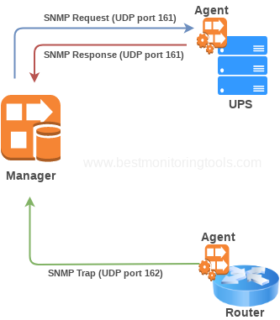
SNMP Enumeration
SNMP enumeration is the process of using SNMP to enumerate user accounts on a target system.
SNMP employs two major types of software components for communication: the SNMP agent, which is located on the networking device, and the SNMP management station, which communicates with the agent.

Slide 53
Advanced Concepts

Slide 54
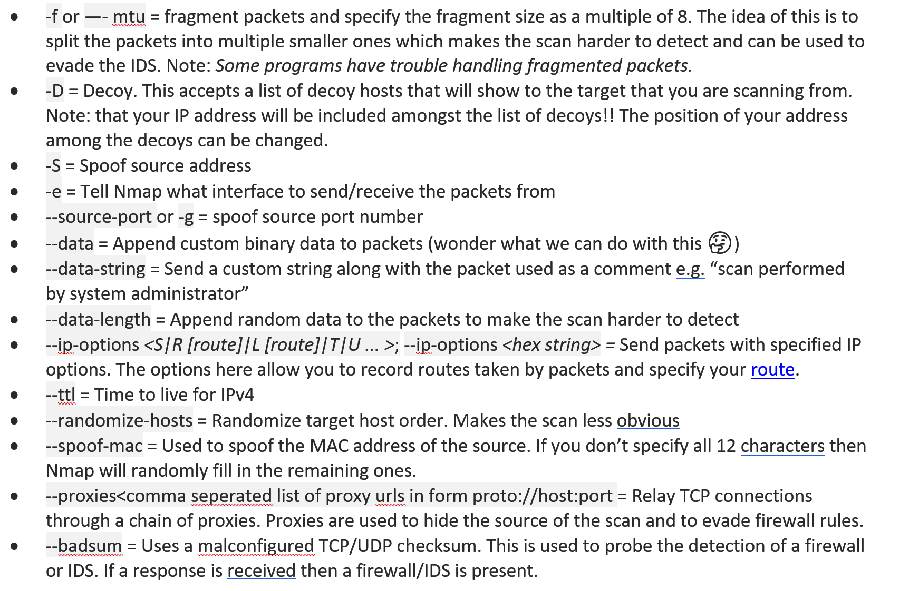
Firewall Evasion and Spoofing

Slide 55
Other Good Tutorials
Nmap Basic exercise
https://phoenixnap.com/kb/nmap-command-linux-examples
Nmap Advanced Tips
https://nmap.org/book/firewall-subversion.html

Slide 56
Unit 4 – Network Security (IV)
Gathering Target Information
Gathering Network and Host Information

Slide 57
Computational Intelligence (TC2027)

